Slide 1


A Terragni
Case Study
Driving Persistency in Life Insurance
TERRAGNI CONSULTING (P) LTD PRIVATE AND CONFIDENTIAL

Slide 2

Client Background
Challenge
What We Did
Strengths
Opportunities
Solutions
Sample
Business Outcomes
Top 4
638
Players In Private Life Insurance Sector
Offices pan India
A Large Workforce Of Insurance Advisors And Other Channel Intermediaries
TERRAGNI CONSULTING (P) LTD PRIVATE AND CONFIDENTIAL

Slide 3

Client Background
Challenge
What We Did
Strengths
Opportunities
Solutions
Sample
Business Outcomes
Inconsistency in Premium renewal
Customer retention
Low Persistency rate of life insurance policies after 3/5 years of sales
More than 63 % of customers are not aware or not comfortable with digital payment gateways for renewals
Lack of information as a product category & financial instrument
(Life Insurance)
TERRAGNI CONSULTING (P) LTD PRIVATE AND CONFIDENTIAL

Slide 4



Client Background
Challenge
What We Did
Strengths
Opportunities
Solutions
Sample
Business Outcomes
Barriers to premium renewal transaction
Areas of high effort and friction in the renewal transaction
Barriers to engagement with Insurance
Emotions and attitudes associated with the product category & their impact on customer behaviour
Barriers to engagement with the Brand
  Emotions and attitudes associated with the brand , product & touchpoints & their impact on customer behaviour
TERRAGNI CONSULTING (P) LTD PRIVATE AND CONFIDENTIAL

Slide 5
^{Quantitative Insights}
Client Background
Challenge
Objective
What We Did
Strengths
Opportunities
Solutions
Sample
Business Outcomes
¹
^{2 lakh+ Records –}
^{3 Years Time Span}
^{Qualitative Insights}
²
Phenomenological in depth interactions for episodic recall.
One-on-One in-depth interactions,
50 hours of interview transcripts
Consumer Neuroscience Based Widespan Assessment
³
^{Released to all the customer}
online studies testing: Trustworthiness, Touch Points Interaction Friction, Redemption Insights
TERRAGNI CONSULTING (P) LTD PRIVATE AND CONFIDENTIAL

Slide 6

Client Background
Challenge
What We Did
Strengths
Opportunities
Solutions
Sample
Business Outcomes
High Claim Settlement Ratio
Reach in terms of physical presence is high
TERRAGNI CONSULTING (P) LTD PRIVATE AND CONFIDENTIAL

Slide 7

Client Background
Challenge
What We Did
Strengths
Opportunities
Solutions
Sample
Business Outcomes
Transparency – Totality & Intuitiveness
Consistency-Across the entire lifecycle
Flexibility- Ability to control outcome
TERRAGNI CONSULTING (P) LTD PRIVATE AND CONFIDENTIAL

Slide 8

Client Background
Challenge
What We Did
Strengths
Opportunities
Solutions
Sample
Business Outcomes
Design
Relevant and timely nudges to drive customer behaviour shifts (EAST* framework for behaviour shifts)
Re-Design
Premium Renewal Processes
Touchpoints
Customer Communication
Customer Data Enrichment
For focussed solution delivery
TERRAGNI CONSULTING (P) LTD PRIVATE AND CONFIDENTIAL

Slide 9
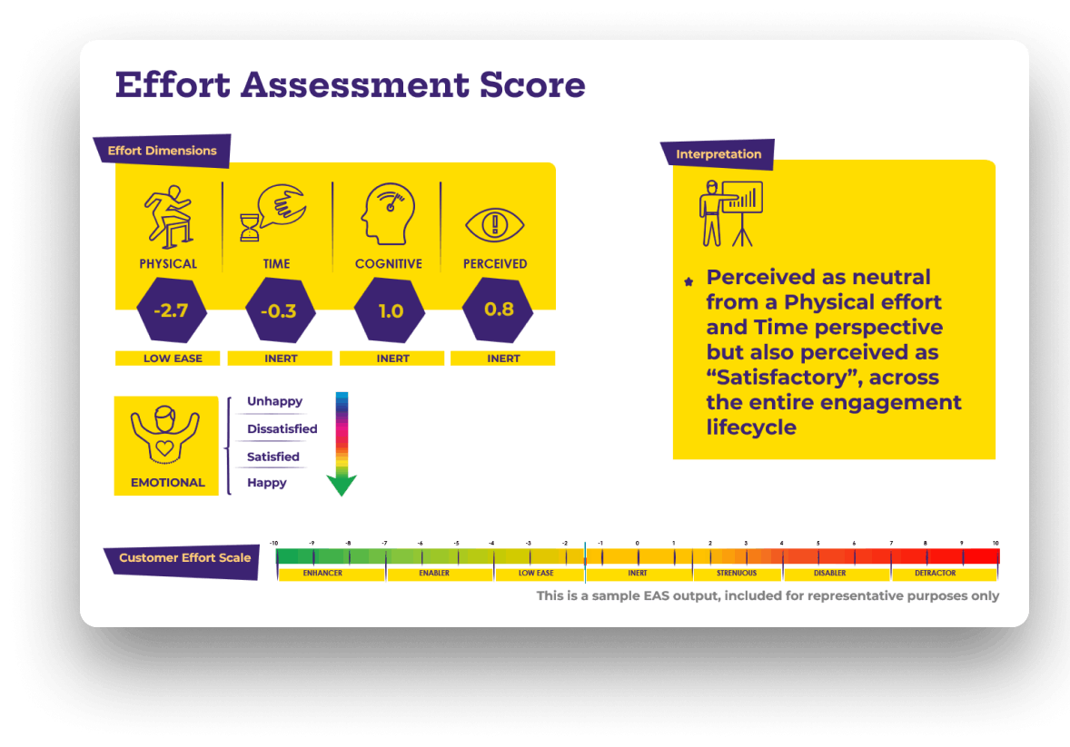
Sample
Client Background
Challenge
What We Did
Strengths
Opportunities
Solutions
Sample
Business Outcomes
TERRAGNI CONSULTING (P) LTD PRIVATE AND CONFIDENTIAL

Slide 10

Client Background
Challenge
What We Did
Strengths
Opportunities
Solutions
Business Outcomes
⬆Improved Persistency
⬆Enhanced Digital (online) Adoption
⬇Reduced Cost of Service
⬆Enhanced Customer Connect and Contactability
TERRAGNI CONSULTING (P) LTD PRIVATE AND CONFIDENTIAL

Slide 11
dipti@terragni.in
+91 895 698 2522
Thank You
TERRAGNI CONSULTING (P) LTD PRIVATE AND CONFIDENTIAL

Slide 12
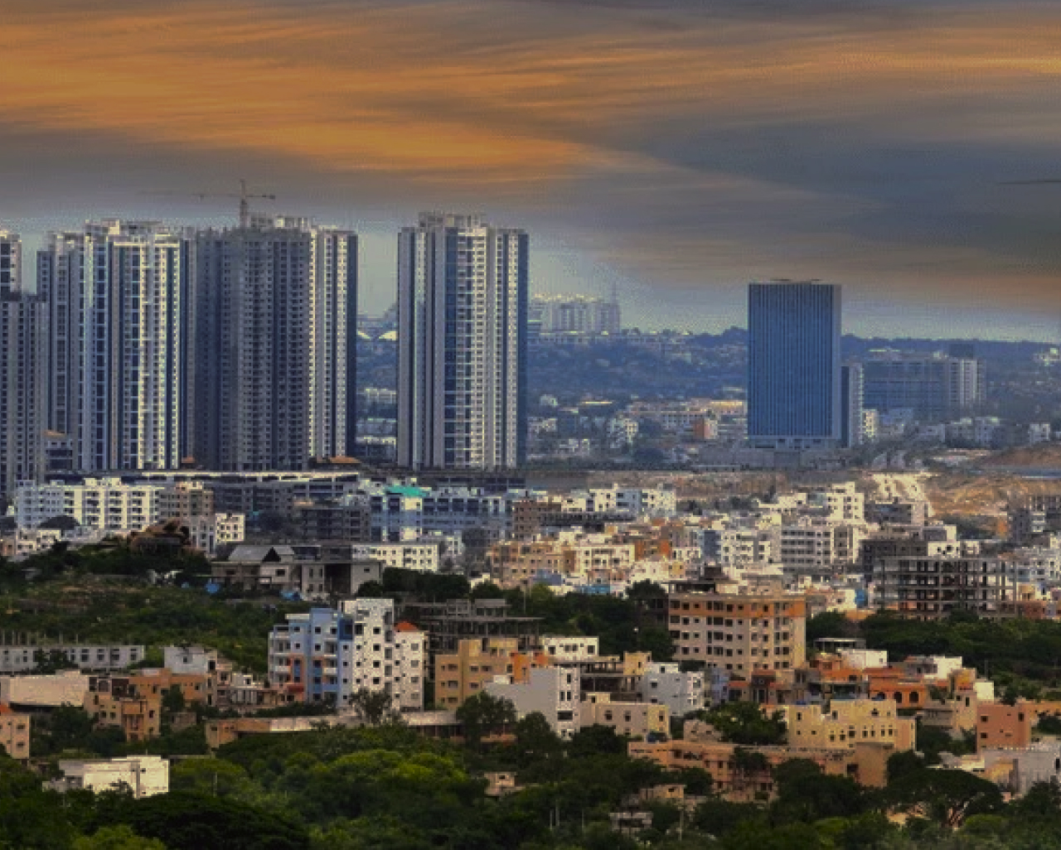


India
London
Bucharest
www.terragni.in
www.buyerbrain.com
TERRAGNI CONSULTING (P) LTD PRIVATE AND CONFIDENTIAL

